Slide 1
MEASURING THE ON-TIME-PERFORMANCE OF BUSES IN THE CHESTER SQUARE NEIGHBORHOOD
Esha Aggarwal, Ari Mayer, Tomer Zur

Slide 2
1.
Motivation/Purpose of our Visualizations

Slide 3
MOTIVATION
Assess the unreliability of the buses traveling through the Chester Square Neighborhood
From our survey, we learned that most residents feel the buses are unreliability
Show the on-time-performance over time of each of the bus line that pass through Chester Square

Slide 4
2. DEMO VIDEO

Slide 5
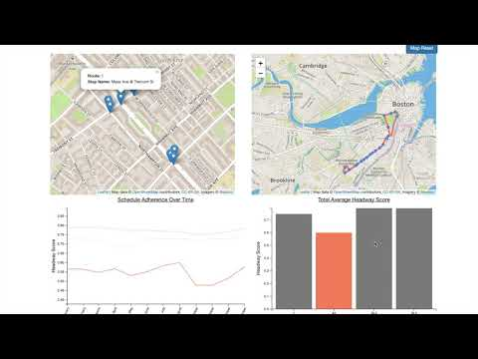

Slide 6
3.
Data Analysis

Slide 7
DATA ANALYSIS
Pulled from MBTA GTFS data
Converted files from text files to csv using Python
Created Python scripts for primary descriptive analysis
Extracted the data we needed in order to create the visualizations

Slide 8
4.
Task Analysis

Slide 9
TASK ANALYSIS
Explain the unreliability of the bus system
Analyze the factors behind the unreliability of the buses
Determine possible improvements for the bus route

Slide 10
5.
Design Process
F19 Project 11 - Final Visualization Sketches

Slide 11
6.
Conclusion

Slide 12
CONCLUSION
The silver lines are significantly more consistent than the other lines which surround the Chester Square Neighborhood.
In the future, we hope to expand this project by detailing the reliability of each specific stop in the neighborhood, as well as tracking the reasoning behind the unreliability.

Slide 13
THANKS!
Any questions?

